Slide 1
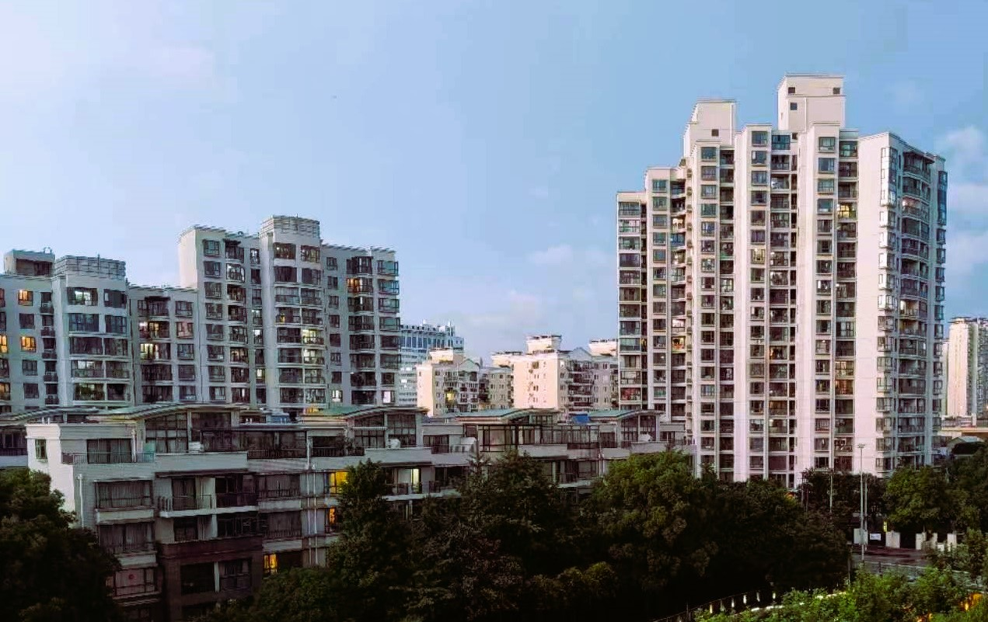
The Struggle of English Commonhold & some thoughts for reforming Scottish law of the tenement
Lu Xu, Lancaster University Law School

Slide 2
Outline
Why Commonhold?
What is Commonhold?
How is Commonhold doing in practice?
What is wrong with Commonhold?
Proposed reforms & reflections

Slide 3
Why Commonhold?
Positive burdens on land for building maintenance
History – 1840s
Restrictive covenants (England) vs real burdens (Scotland)
Two possible solutions
Statutory ‘land obligations’ – still waiting to happen, since 1965
Leasehold – getting rid of ‘land-ownership’ through contractual obligations

Slide 4
Leasehold
The ‘fundamentally flawed’ system of leasehold
Systemic mismatch of power, interest, purpose and responsibility between the freeholder and leaseholders
A long list of problems: excessive ground rent, high charges for consent, poor management and maintenance, safety concerns

Slide 5
What is Commonhold?
Statutory structure of land / apartment ownership and management
First proposed in 1987, enacted by the Commonhold and Leasehold Reform Act 2002, commenced in 2004
Many comparable systems around the world: condominium, strata title, sectional title

Slide 6
Components of Commonhold
Individual ownership of each ‘commonhold unit’
Membership of commonhold association (the body corporate)
The commonhold association owns all common parts outside of individual units.
No co-ownership of common parts by any individual owners
Ownership and control through the commonhold association enhances its role

Slide 7

Advantages of Commonhold
Ownership (freehold tenure) of units
Minimal common ownership – takes away much of the difficulty of property law
Commonhold association as the obvious entity for ownership (of common parts), maintenance and management
No systemic conflict of interests in general among owner members and the association

Slide 8
Commonhold in practice
Governmental estimate following the 2002 Act: 6,500 new commonhold units every year (relative to 110,000 new leasehold units)
By 2014, 16 schemes comprising 141 commonhold units in England and Wales.
By 2020, little change to commonhold.
In comparison, over 200,000 new leasehold dwellings are created each year.

Slide 9
What’s wrong with Commonhold?
Some doctrinal issues for consideration
Commonhold association as a company limited by guarantee
Lack of enforcement measures
Lack of dispute resolution capacity
Statutory default structure not sophisticated enough to deal with large, complicated, mixed-use developments
Almost impossible to convert leasehold into commonhold due to the requirement of unanimous consent
Overall the legal framework is workable without significant difficulties for the small number of commonhold schemes in operation

Slide 10
Practical challenges for commonhold
Competing against leasehold
Imbalance of influence, power, benefit and interest
Theorists
Developers / legal advisors
Buyers / owners
Mortgage lenders
Lack of understanding across the whole spectrum due to the absence of any scale or momentum of commonhold

Slide 11
Proposed Reforms
Flesh out the operational details for the company limited by guarantee
More sophisticated structures if needed (e.g. different ‘sections’ for commercial and residential units within a larger commonhold scheme)
Conversion from leasehold with only 50% consent from owners (but who pays the conversion cost on behalf of those who are not in support of conversion?)
Ground rent now banned in new leasehold from July 2022

Slide 12
Reflections
Starting a brand new system to compete against the well established practice is always challenging.
Theoretical advantages are not enough to overcome practical obstacles, vested interest and inertia.
Law reforms in this area require coordinated and conjoined efforts from the legislature, the executive, developers, banks, professionals and the general public.

