Slide 1
Unit ownership in Polish law
Associate Prof. (dr hab. Prof. UŚ) Magdalena Habdas,
University of Silesia in Katowice, Poland
Faculty of Law and Administration

Slide 2
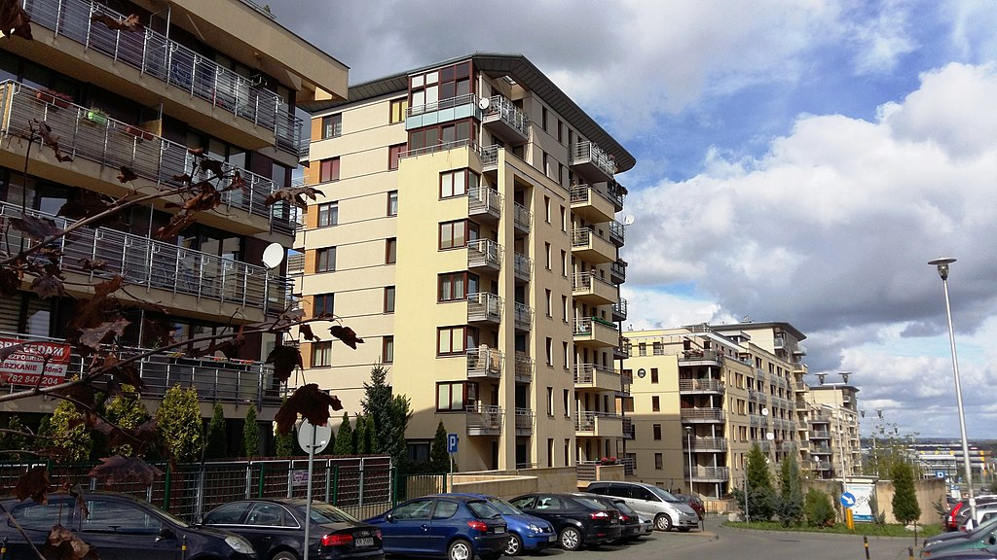
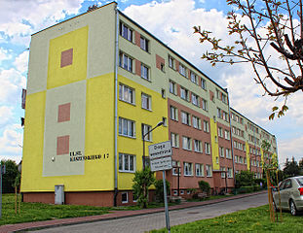
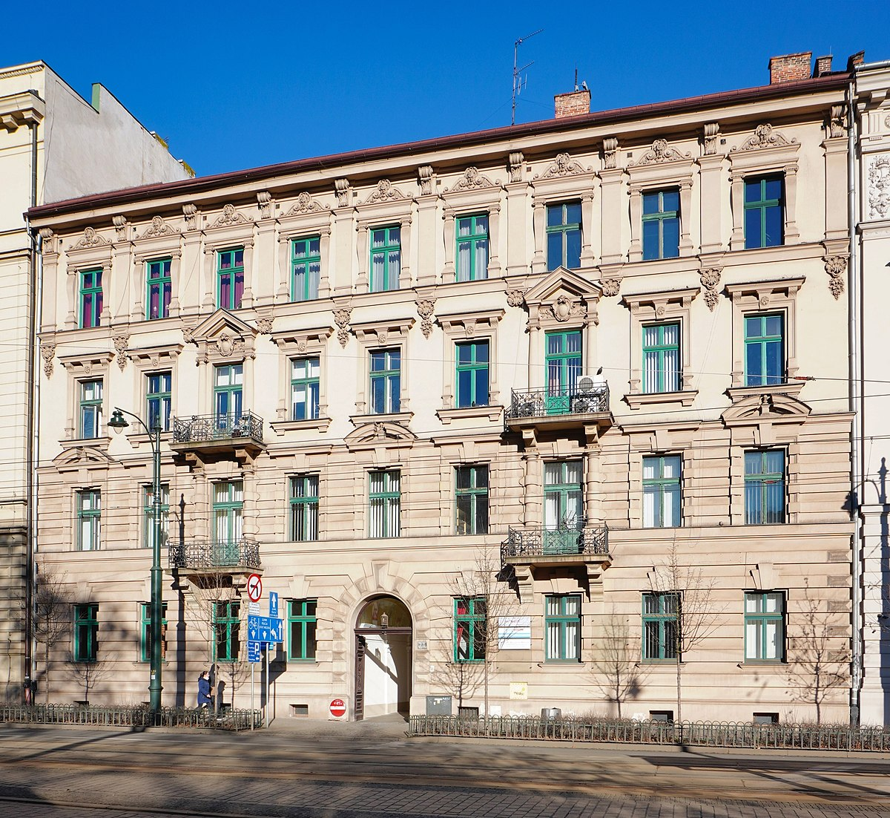
Condominium schemes - unit ownership
gained increased popularity after Poland’s shift to a democratic system
new model:
1994 Law on Unit Ownership (LUO)
(25 years anniversary !)
an important alternative to co-operative flats:
newly built developments,
older buildings often previously owned by local authorities.
This Photo by Unknown Author is licensed under CC BY-SA
This Photo by Unknown Author is licensed under CC BY-SA
This Photo by Unknown Author is licensed under CC BY-SA

Slide 3
Residential or other
(retail, office, other services)
THE UNIT
Component part:
Garage cubicle
Utility room
Basement cubicle
Component part:
SHARE IN COMMON PROPERTY
Share in the right of co-ownership of land
Share in common parts of the building
(usable area of unit/
usable area of all units in a building)
Share determines: 1) voting, 2) liability, 3) costs, 4) proceeds

Slide 4
THE UNIT
has a separate ’unit’ register
the unit register indicates the land register kept for land on which the building with units stands,
the land register lists all registers of isolated units
is an object of ownership
may be sold (always together with component parts)
may be encumbered by a mortgage (shown in the unit register)

Slide 5

The residential community
art. 6 LUO: owners of units form a “residential community” which comes into existence as soon as at least one unit has been isolated and subsequently transferred to a party other than the original owner of all the units,
no legal personality („defective legal person”) may acquire rights and create obligations and be both plaintiff and defendant in litigation,
capacity only to manage common parts:
not entitled to invest or conduct economic activity on the market
LIABILITY:
COMMUNITY + OWNERS UP TO SHARE VALUE

Slide 6
The residential community
SMALL – 3 and less units
LARGE – 4 and more units
MANAGEMENT:
Small: ordinary management – majority according to shares
extraordinary management – unanimity
LARGE: ordinary management – performed by the management board
extraordinary management – majority resolution according to shares
or if majority of shares is owned by one owner, holders of 1/5 of shares may demand that voting is done according to 1 owner – 1 vote principle
LUO - the residential community may only pass resolutions concerning the management of common property and may establish house rules.
no other bylaws (in practice often enacted) .

Slide 7
House rules
No statutory definition: pertain to activities both within a unit as well as on common property and contain principles of conduct,
may take the form of a written document, i.e. a regulation on house rules, but may also function through custom
no special rules in LUO for adopting house rules - ordinary or extraordinary management?,
the line between an acceptable an unacceptable limitation of unit ownership is very fine
The r.c. cannot impose penalties on unit-owners who violate house rules or other statutory duties because it is not a body with administrative/public law powers
The r.c. has no „soft” legal instruments to motivate unit owners to abide by house rules – only forced sale of unit

Slide 8


MANAGEMENT PROBLEMS – large communities
Problems with resolutions requiring a majority of share votes (inactive owners, absent owners) – resolutions pending for months (!)
No dedicated provisions to costly repairs, energy efficiency investments, etc. – danger of neglecting interests of less wealthy unit owners
No conflict resolution mechanisms within LOU
– only access to court for unit owner or management board if unhappy with resolution (violation of law, other resolutions, contrary to prudent management standards)

Slide 9

CONSTANT TENSIONS – defective legal person
Residential community or all unit owners?
Buying adjacent land to enlarge parking lot
Taking out a bank loan
Encumbering common land with an easement of necessary way
Serving court documents (!)
Suing (who, how?)

Slide 10


conclusions
THINGS WE GOT RIGHT (MOSTLY)
The concept of a unit as a separate immovable
Unit and land registers
Obligation to contribute to maintenance and repair of common parts,
THINGS WE GOT WRONG
the legislator has fallen short of providing principles needed for an orderly operation of a residential community (no regulation of constitutions/by-laws, no special voting mechanisms for selected matters, no interim measures to motivate unit owners to comply with their financial and social obligations)
Problems with legal status of the residential community
Inefficient default management rules.

Slide 11
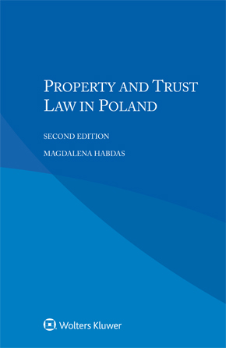
THANK YOU FOR YOUR ATTENTION !
magdalena.habdas@us.edu.pl

