Slide 1

Discussion Paper on Tenement law: compulsory owners’ associations
Professor Frankie McCarthy
frankie.mccarthy@scotlawcom.gov.uk

Slide 2

Why this project?
Declining condition of tenement stock
Scottish Parliament Working Group on Tenement Maintenance
Owners’ associations
  Legal personality
  Owners as members
  Annual budget and service charge
  Manager
SLC project: how to implement?
Consultation open until 1st August 2024

Slide 3

Policy context
Increased regulation of homeownership
  Housing in declining condition
  Housing shortages
  Fuel poverty/climate emergency
Heat in Buildings legislation
Tenure-neutral housing standard

Slide 4

Framework of current law
Tenements (Scotland) Act 2004
Main body of Act
  Default rules of ownership of parts of tenements
  Right to apply to court to resolve disputes
  Duties re maintenance
  Duties to insure, to provide access, to allow installation of pipes etc
  Demolition and abandonment
Schedule 1: Tenement Management Scheme

Slide 5
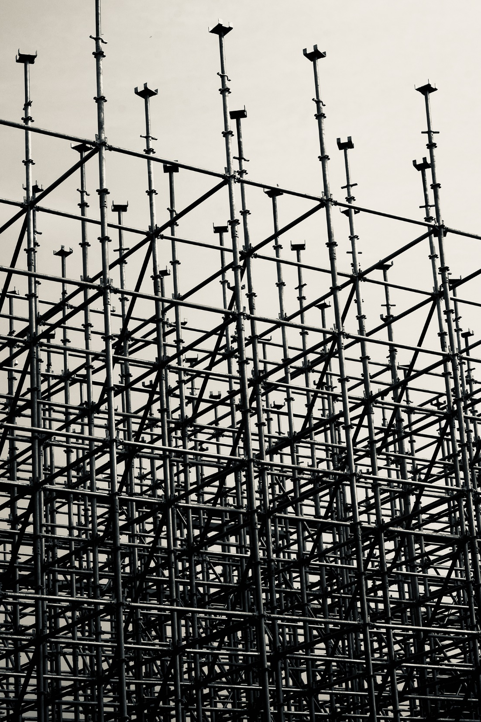
Future framework: mandatory elements
Creation of OA for every tenement
Flat owners become members
Mandatory duties on OA
  Appointment of manager
  Annual meeting
  Annual budget
  [Registration requirement]
Enforcement of mandatory duties
  Court-appointed remedial manager
  Who can apply to court?
  Local authority as remedial manager of last resort

Slide 6

Future framework: default elements
Owners’ Association Scheme (OAS) to replace TMS
Why not mandatory?
  A1P1 and freedom to choose
  Pragmatic arguments
Standardising the drafting of title conditions
  Requirements for conditions created post-OA legislation
  Requirements for existing conditions?

Slide 7

Applying the framework
Which tenements should the legislation apply to?
  Problems with disapplying the regime from certain tenement types
  Small tenements
  Tenements where all flats are in single ownership
  Tenements managed as part of a wider development
  Tenements subject to a DMS

Slide 8

The Owners’ Association
Which type of legal person?
Which should be members?
General administration
  Members names and contact details
  Signing and sending

Slide 9

The OAS:
Function and powers of the OA
Decision making by members
Manager role and responsibilities
Liability for costs
Enforcement
  Disputes for FTT?
  Court approval for annual budget?
  Tenement-restricted land attachment?

Slide 10

Questions?

